Slide 1
Ecosystem of Hadoop
Science research in UIT lab

Slide 2
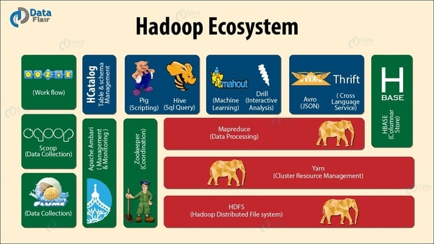
Chapter summary:
Avro
Hbase
Hive
Pig
Spark
ZooKeeper

Slide 3


Slide 4
Apache Avro:
Apache Avro is likely a data format:
Support Multi language.
Cover lack of language portability in Hadoop.
Sharable.
Potential future-proof technology.
➔ Why we use this instead of other data format ?

Slide 5
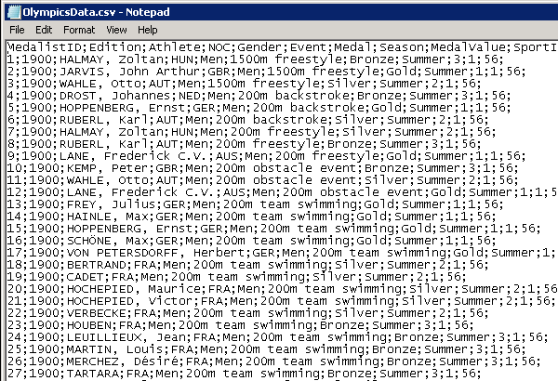
Apache Avro: Evolution of data
Comma Separated Value(CSV):
Data type is not guaranteed.
Tricky to analysis with comma.
Can be no column name.

Slide 6
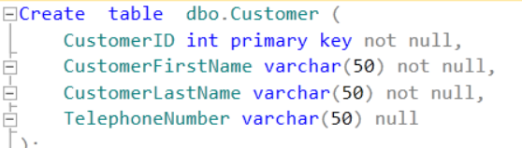
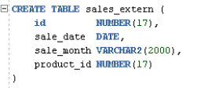
Apache Avro: Evolution of data
SQL server:
Relational tables definitions:
‘’Flat” characteristic.
Different Syntax among databases.
Oracle:

Slide 7
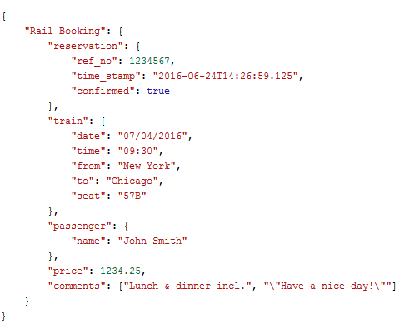
Apache Avro: Evolution of data
JSON (JavaScript Object Notation):
No Schema Enforcing.
Big in Size due to Repeated keys.

Slide 8
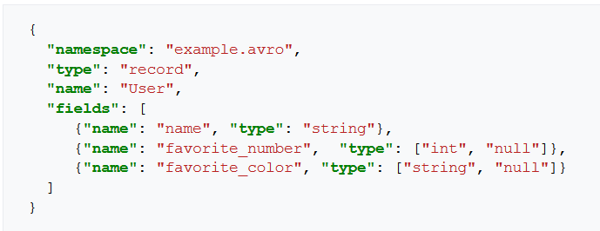
Apache Avro: Evolution of data
Avro :
Fully Typed.
Data with Schema.
Readable for any language.
Evolving with time.

Slide 9


Slide 10
Hbase:
HBase is a distributed column-oriented database:
Built on top of HDFS.
Support real-time read/write random access.
Unlike relational database systems.
➔ No query support.
Assist Apache Avro, REST, and Thrift.

Slide 11
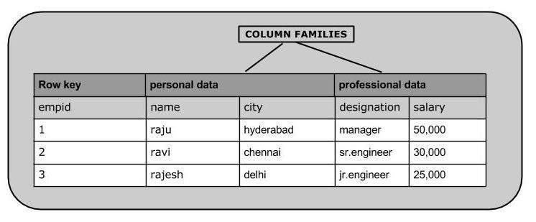
Hbase:
An HBase system comprises a set of tables:
Primary Key (Row Key).
Column Families.

Slide 12
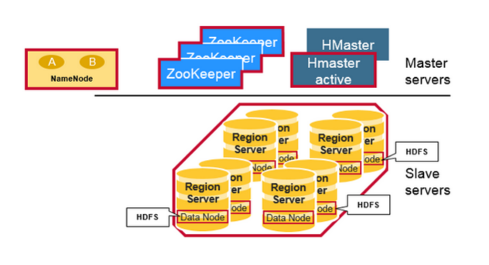
Hbase:
Hbase has 3 primary components:
Hmaster:
Region assignment.
DDL operations.
Zookeeper:
Storage of metadata and region info.
Hregion Server:
Monitoring and storing regions.
Assign request for particular regions contain column family.

Slide 13
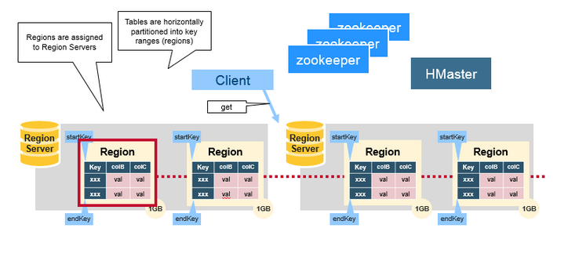
Hbase:
Region:
Contain data devided by horizontal distribution.
Include 2 components ,namely memstore and Hfile.

Slide 14
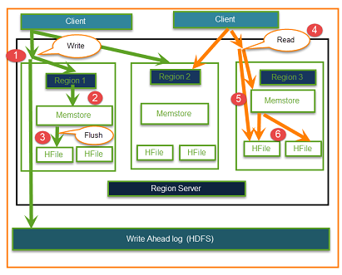
Hbase:
2 reasons for the existence of HFile:
Sorting with distributed strategy.
Data flow optimizing when using the Log-Structured Merge Tree.

Slide 15


Slide 16
Apache Hive:
The Apache Hive ™ data warehouse software:
reading, writing, and managing large datasets.
Using SQL.
While initially developed by Facebook.
The Apache Hive ™ provide following functions:
Data Summarization
Query
Analysis
➔ Why we use Hive in Hadoop?

Slide 17
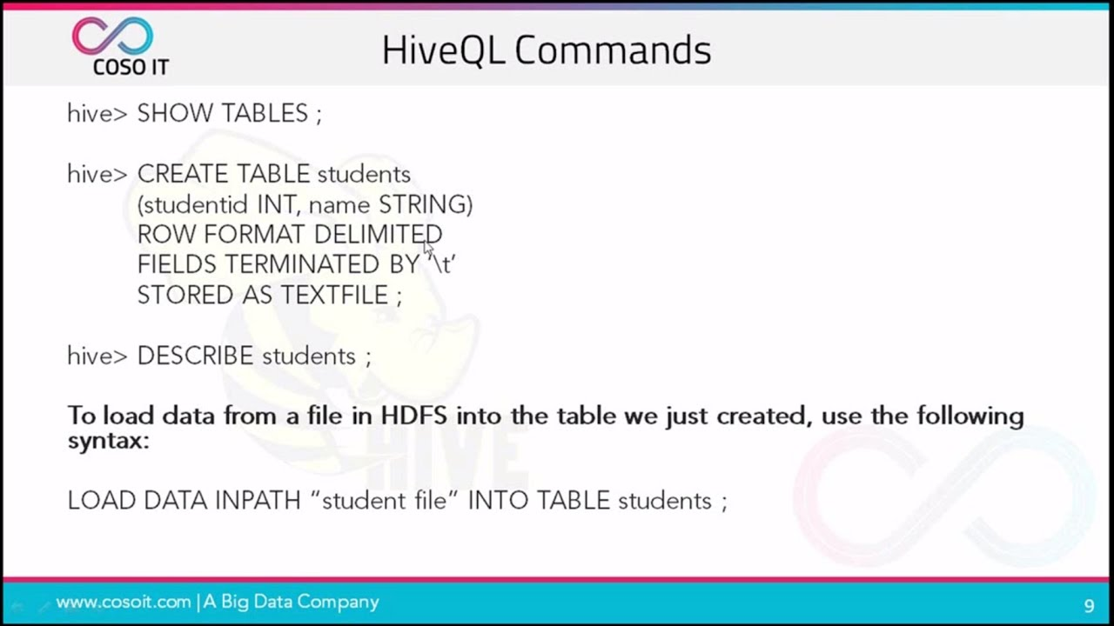
Apache Hive:
The Apache Hive ™ uses HiveQL:
query data.
Indexing.

Slide 18
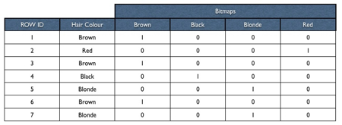
Apache Hive:
Indexing in HiveQl also includes special database index - bitmap indexes:

Slide 19


Slide 20
Apache Pig:
Apache pig - platform for analyzing large data sets:
Using Pig Latin – script language.
Developed originally by Yahoo.
Why we need Pig?
Not so good at Java.
Struggling with MapReduce tasks.

Slide 21
Apache Pig:
What make the different between Pig and Hive ?
Support UDFs – user-defined function in Java, python, javascript, Ruby and Groovy.
Handle all kind of data.
VS

Slide 22
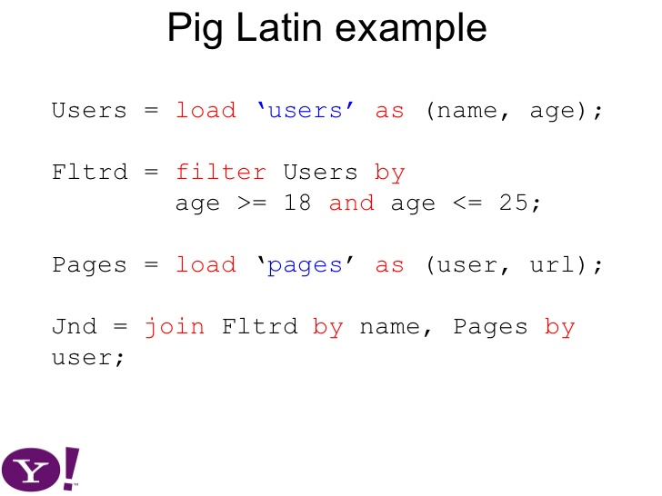
Apache Pig:
The Example:

Slide 23


Slide 24
Apache spark:
Apache Spark is a cluster computing framework:
Large-scale data processing.
Not using MapReduce.
Use its own distributed runtime.
Spark is closely integrated with Hadoop.

Slide 25
Apache spark:
Spark Advantage:
build analytics tools.
keep large working datasets in memory between jobs.
Two styles of application that benefit from this model:
Iterative algorithms.
Interactive analysis.

Slide 26
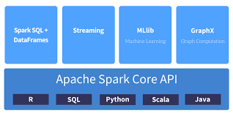
Apache spark:
Spark provides APIs for:
Scala, Java, Python, R and SQL.
the Apache Spark project:
machine learning (MLlib).
graph processing (GraphX),.
stream processing (Spark Streaming).
SQL (Spark SQL).

Slide 27


Slide 28

Zookeeper:
ZooKeeper is a centralized service:
Cluster management.
Synchronization between masters & clients.
Adopted in Hadoop from version 2.0.
➔ Why we want to use this service ?
Make coordination between Hadoop nodes.

Slide 29
Zookeeper:
ZooKeeper tasks:
Manage configuration across nodes.
Implement reliable messaging.
Implement redundant services.
Synchronize process execution.

Slide 30
Preference:
https://www.ibm.com/analytics/hadoop/hbase
https://www.youtube.com/watch?v=IumVWII3fRQ
https://www.youtube.com/watch?v=9CREwiemvT0
http://javaarm.com/file/apache/Hadoop/books/Hadoop-The.Definitive.Guide_4.edition_a_Tom.White_April-2015.pdf
https://en.wikipedia.org/wiki/Apache_HBase
https://mapr.com/blog/in-depth-look-hbase-architecture/
https://viblo.asia/p/hbase-overview-architecture-va-data-flow-63vKj6J6K2R

Slide 31

The end!

